Slide 1
Groundwater Sustainability Pt. 1 - Definition & Consequences
CE 547 – BRIGHAM YOUNG UNIVERSITY

Slide 2
Lecture Objectives
Understand the concept of groundwater sustainability
Be able to define perennial yield (safe yield, sustainable yield)
Understand the negative consequences of unsustainable groundwater use

Slide 3
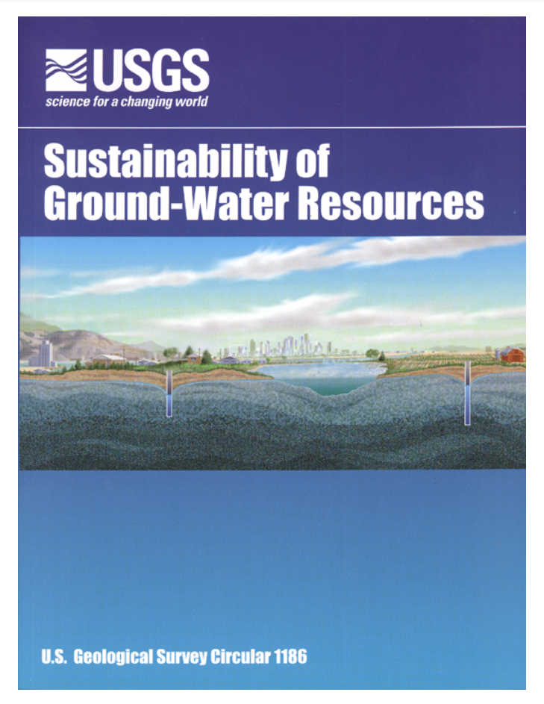
Resource Material
Alley, W. M., Reilly, T. E., & Franke, O. L. (1999). Sustainability of ground-water resources (Vol. 1186). US Department of the Interior, US Geological Survey.

Slide 4
Definition
“Development and use of ground water in a manner that can be maintained for an indefinite time without causing unacceptable environmental, economic, or social consequences.” - Alley, Reilly, and Franke, 1999
Related terms: “Safe yield”, “Sustainable Yield”, “Perennial Yield”

Slide 5
Perennial Yield
“. . . the maximum amount of water of usable chemical quality that can be withdrawn and consumed economically each year for an indefinite period of time… Perennial yield cannot exceed the natural recharge to an area indefinitely, and ultimately it is limited to the amount of natural discharge that can be salvaged for beneficial use.” -- Rush and Kazmi 1965

Slide 6

Aquifer Subsidence
water table drops → pore pressure (u) decreases
Δz = aquifer compression
pore pressure (u) decrease
effective stress (σ’) increase
This process is non-elastic. If you refill the aquifer, the lost void space is only partially recovered. I.e., permanent loss of storage capacity.
= σ’ + u
σ’ = σ – u
If u ⬇ , then σ’ ⬆

Slide 7
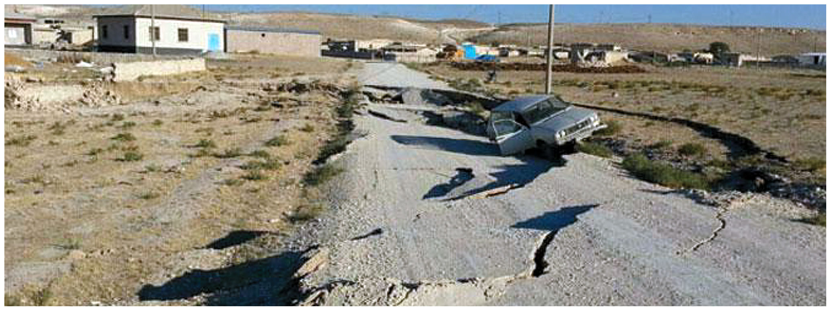
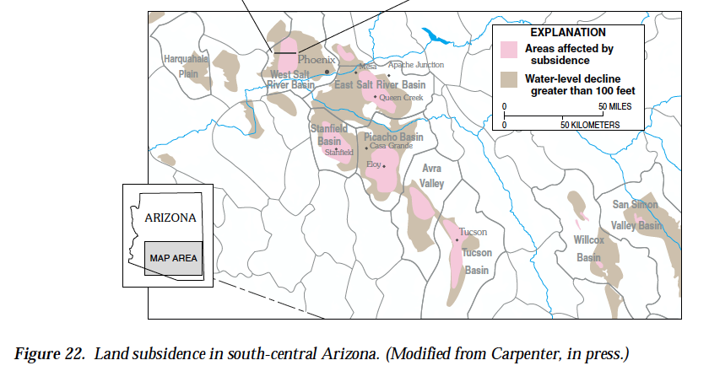
Konya, Turkey

Slide 8
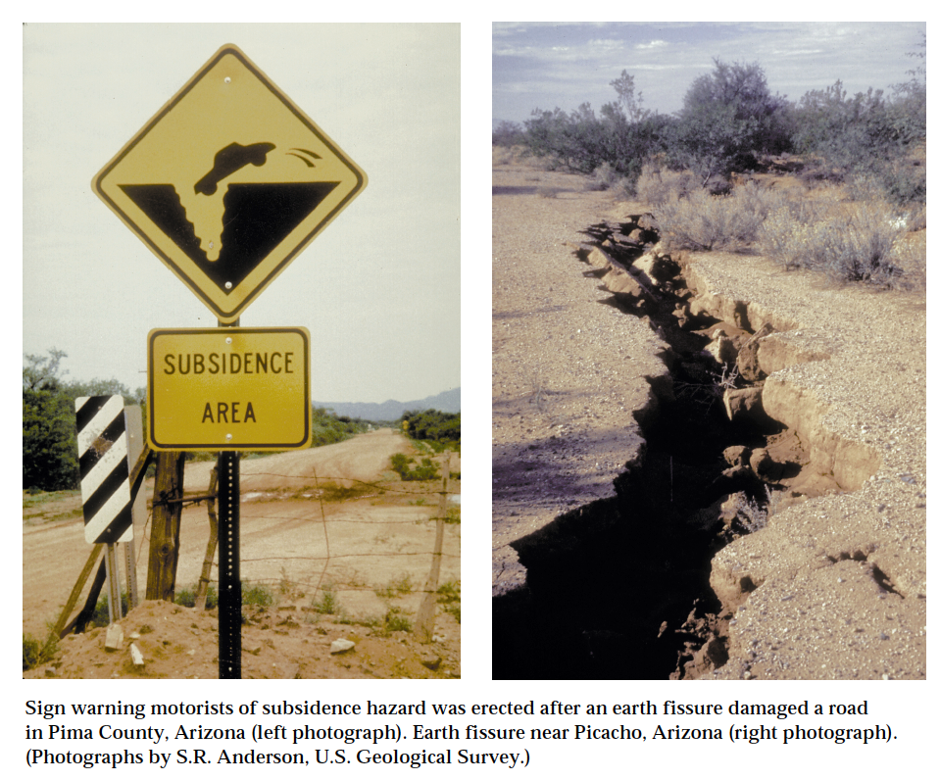

Slide 9
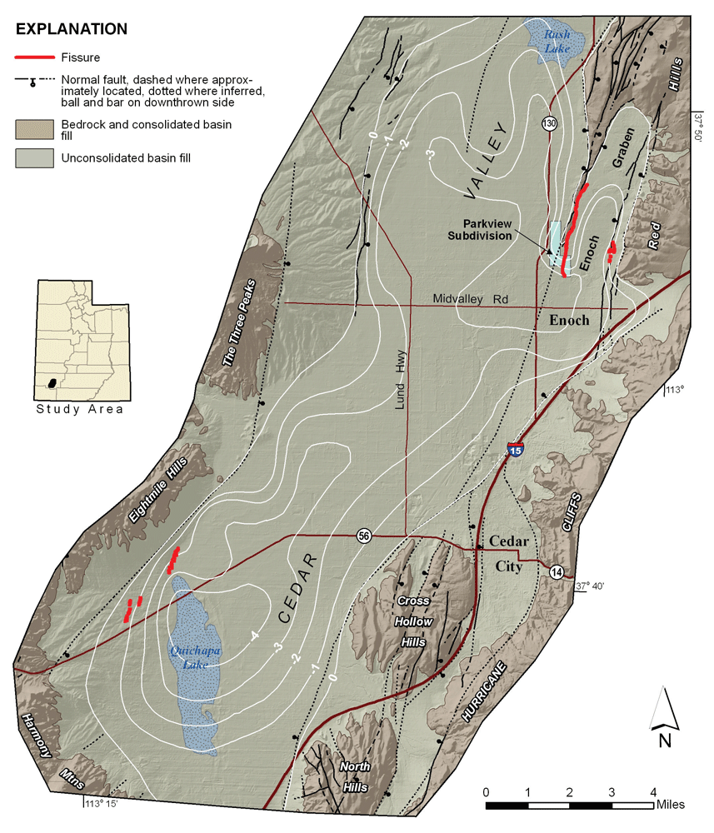
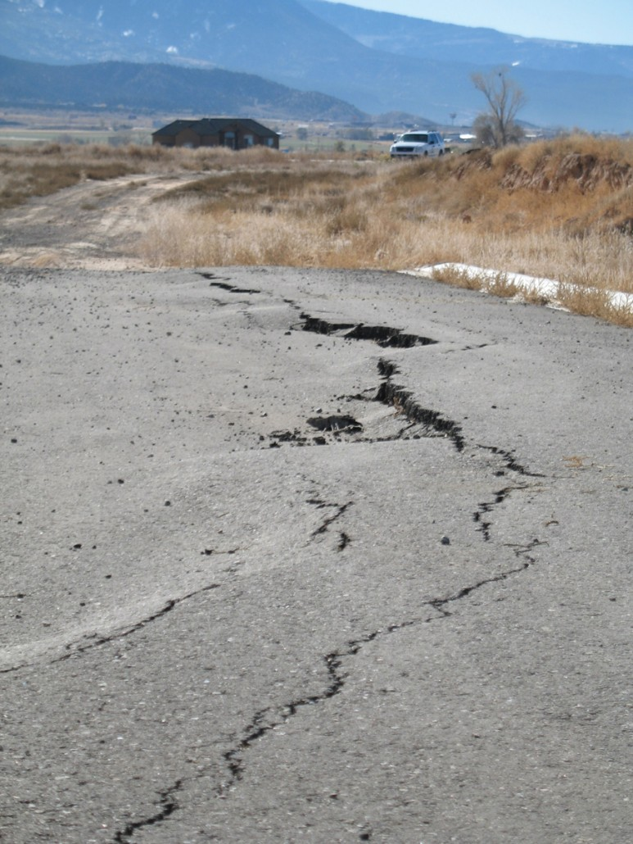

Slide 10
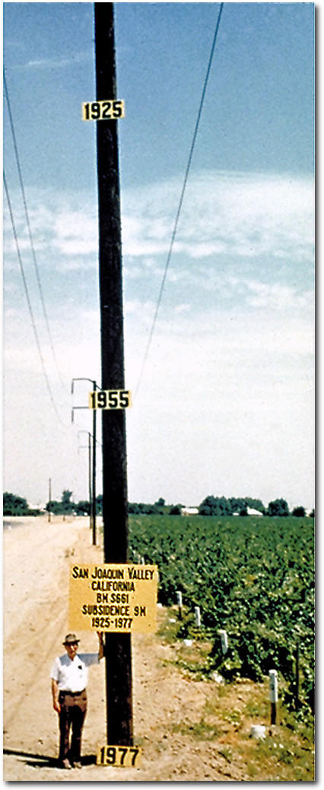
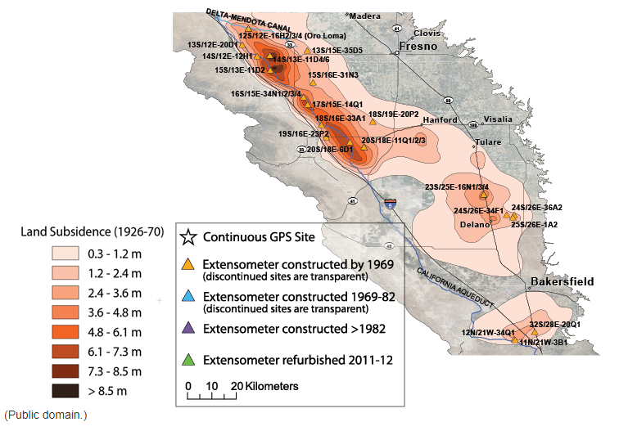
San Joaquin Valley - California

Slide 11
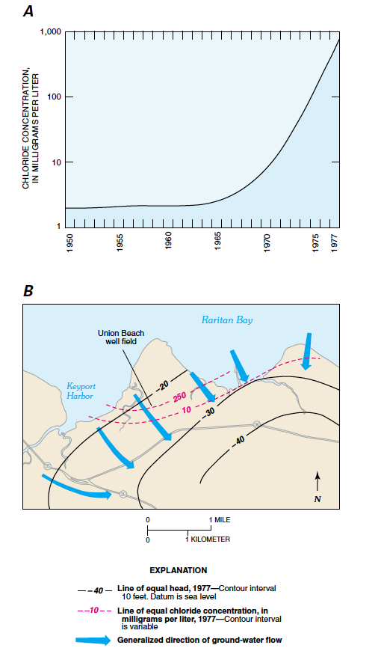
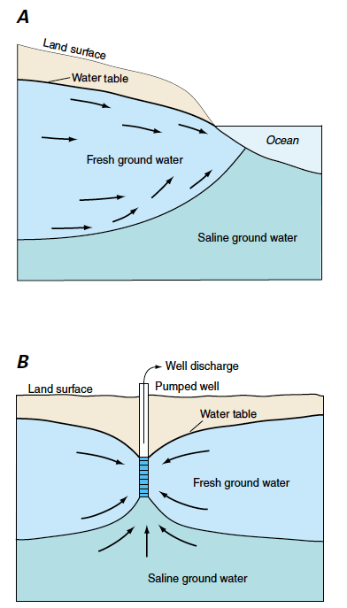
Saltwater Intrusion

Slide 12
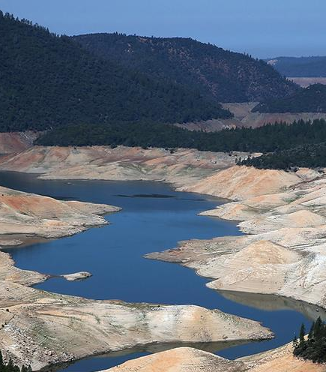
Drought Mitigation
Groundwater acts as an underground water reservoir
In times of drought, groundwater is used to alleviate critical water shortages
If groundwater reserves are depleted, the impacts of droughts can be catastrophic

